Slide 1
Foundations of Computer Science for Researchers

Slide 2
Goals for this lesson
Big picture stuff--what is a programming language? What do programs do?
Differences between programming languages
What are the most commonly used languages?
Why Python?
Programming environments
Compiler versions.
IDEs (integrated development environment).
Reproducibility--GitHub, BitBucket, Atlassian, etc.
Start programming!

Slide 3
Class goals
Grasp fundamentals of computer programming
Computational tools
Data structures
Syntax
Apply fundamentals to other programming languages
Ask the right questions for the next steps

Slide 4
Programming languages
What are they?
Automates and executes algorithms in a structured format.
So what is an algorithm?
A series of instructions constructed to solve a problem.
Examples: instructions on the back of your cake mix, manual for assembling furniture, and so forth.
Some problems cannot be solved using an algorithm--undecidable, unsolvable, intractable problems.
Usually serves as an intermediary between natural languages and assembly language.

Slide 5
Programming languages
How do they compare to natural languages?
Formally defined syntax and semantics. Will often have a lexicon of keywords.
Unambiguous. Computers cannot resolve ambiguity like humans can.
Must be implementable.
Turing complete
Replicability, predictability, consistency.
For all Turing machines T and input i, there exists a result r, such that all machines T and i will produce the same r.
Arithmetic rules stipulate that 2 + 2 must always yield 4.

Slide 6
Programming languages
What do programs do?
Almost everything.
“There are more things in heaven and earth, Horatio, than are dreamt of in your philosophy.” (from Shakespeare’s Hamlet). Limitations are set by the extent of your knowledge and imagination.

Slide 7

Programming languages
For each day in month:
print(day)
eat()
exercise()
read()
learn()
Programmer (that’s you)
?
Computational problem
Write a program!

Slide 8
Types of programming languages
High-level languages
More similar to natural languages than low-level languages.
Handles computational problems designed by programmer.
Constructs represent mathematics.
C++, Java, Python, MATLAB, Javascript, C#.
Low-level languages
Languages which communicate instructions to computer microarchitecture.
Pertains to hardware underlying your software.
Several levels removed from the user.
Assembly language, machine language, and some say C...

Slide 9
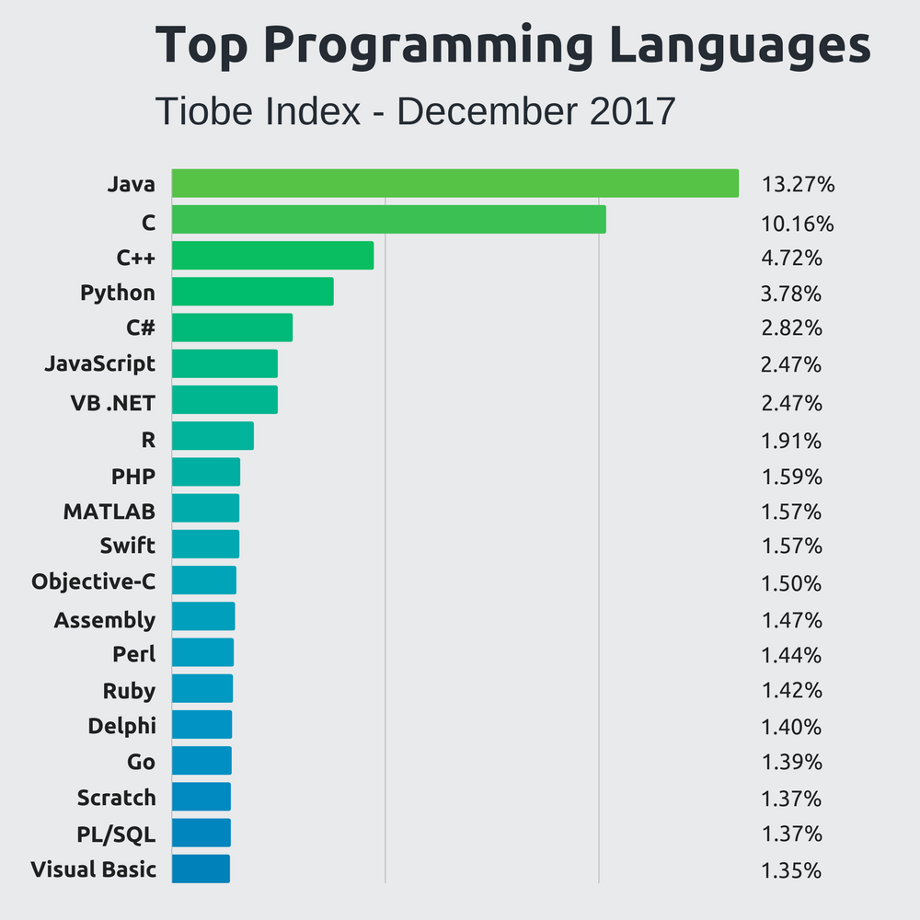
What are common languages out there?
Stackify 2018

Slide 10
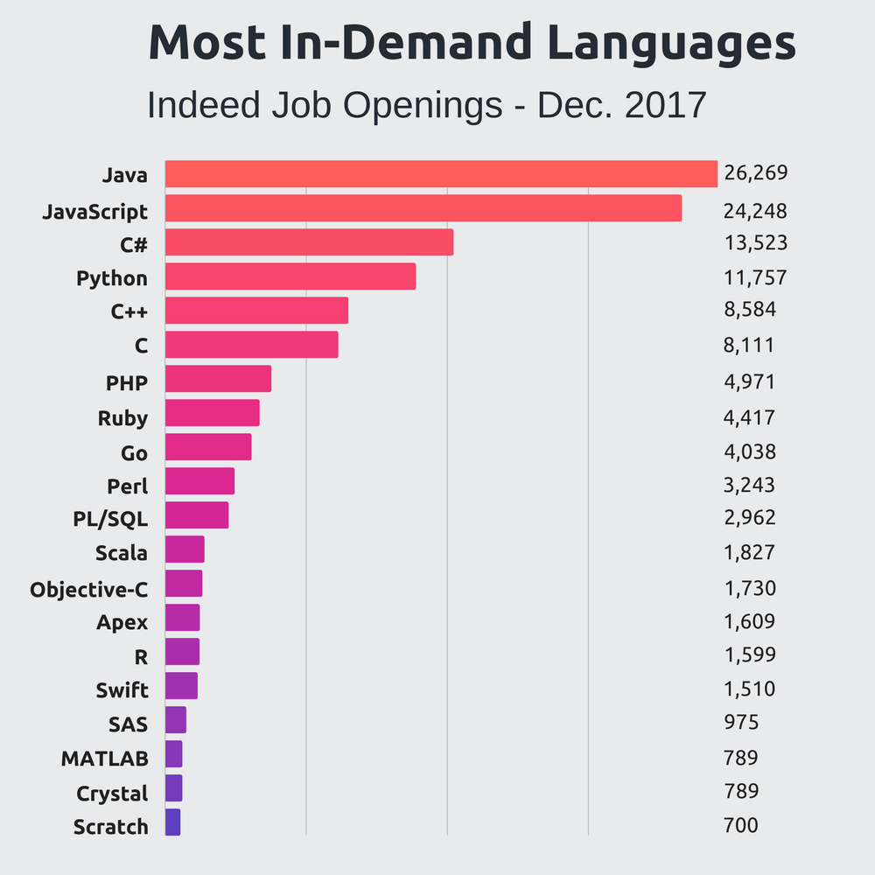
What are common languages out there?
Stackify 2018

Slide 11
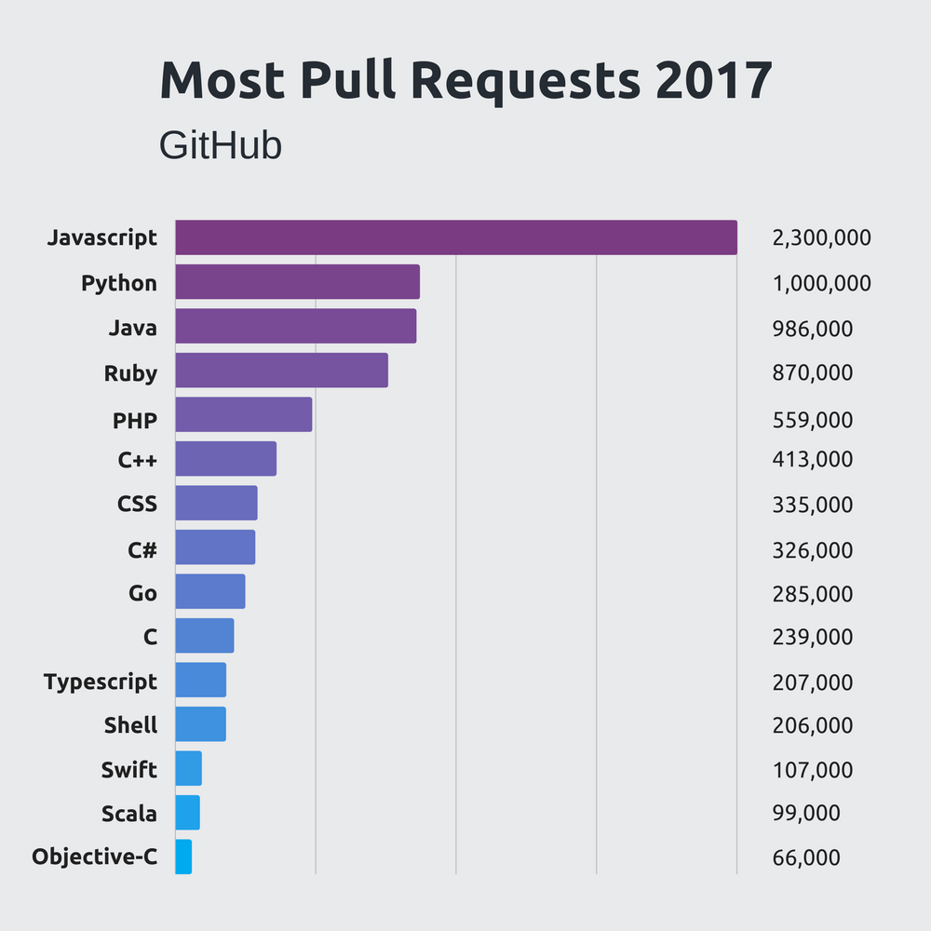
What are common languages out there?
Stackify 2018

Slide 12
Which language should I choose?
Functionality
Data analysis, machine learning → Python, MATLAB
Software development and engineering → Java, C, C++
Hardware manipulation → C
Database management, querying → SQL, MySQL, PostGres
Web development → Javascript, C#

Slide 13
Why Python?
Functionality
Fundamentals of computer science made easier with Python.
Machine learning libraries for data science projects in future.
High demand and usage in academia and industry
Open-source, free of cost
Extensively documented
Important for troubleshooting…

Slide 14
Programming Environments

Slide 15
IDE (Integrated Development Environment)
Supports only a few select programs per IDE
We will use PyCharm, which only supports Python.
NetBeans and IntelliJ support Java.
Xcode, built for Mac, is for Java, C++, C.
Organization
One project may have more than one program for modularity purposes.
Multiple projects in same IDE.
Debugging
No one writes a perfect program in his/her/their first pass.
Set breakpoints to see which values are being changed as the program executes.

Slide 16
Compilers
Each language has multiple versions of its own compiler
Translates high-level programs into machine-readable format
Checks syntax
Kind of like a spellchecker, they pick up on syntactical errors before programs are executed.
Compiler errors
Throw errors if incorrect syntax is detected.
Usually cannot execute programs with compiler errors.
More on this later...

Slide 17
Saving and Reproducing Code
SAVE YOUR CODE
Cloud servers such as the lab DropBox account
Google Drive
There are no excuses for lost code these days….
GitHub
Programmer’s preferred way of storing, sharing, and viewing code from other programmers.
Social media for programmers.
This is how you show off your code.
Get an account for next time.

Slide 18
Open Discussion
Which topics interest you most?
How were the slides?
Would you like to learn about anything I mentioned in more depth?
How should I structure classes to be most conducive to learning how to code?
Is there anything you didn’t understand?
How should we handle homework assignments and readings?

Slide 19
Foundations of Computer Science for Researchers
Week 2

Slide 20
Progress
Any questions from last week?
GitHub accounts
Caroline: guidodarezzo
More resources for coding practice
LeetCode
HackerRank
Reading
MIT OCW (Opencourseware)
https://ocw.mit.edu/courses/electrical-engineering-and-computer-science/6-00-introduction-to-computer-science-and-programming-fall-2008/readings/
John Guttag’s Introduction to Computation and Programming Using Python was my first intro CS book.
Updated versions
Data science version?
IDE issues?

Slide 21
Goals for this lesson
Functions
Purpose
Introduction to a function call
Print statements
Input function
Variables
Basic math operations
Adding your code to GitHub

Slide 22
Purpose of a function
In CS and Math, a function is a series of operations, performed on an input, which produces an output of some kind.
Familiar version from math
Parabolic function: f(x) = x²
x is the input, the product of x² is the output, and the given operations call for multiplication.
Same idea, different representation in CS
Different languages, slightly different representation.
Basic structure of a function is shared throughout most languages.
f(x) is the name of the function.
x is an argument that we pass to the function (parameter passing).
Parentheses denote beginning and end of parameter.
Operations are written inside of the body of the function.
Outputs are stored in memory or printed to the console.

Slide 23
Function call
Act of invoking a function
Programmer must decide on its use
When to invoke.
Which arguments to pass (parameter passing).
Where to store output.

Slide 24
Print function in Python
Console output
Means whatever you decide to print will appear on your screen.
Super useful for debugging, FYI…
Arguments
0 or more
Strings
Anything enclosed in a single apostrophe, quotation mark, triple quote, or triple apostrophe.
Examples:
print(‘Hello, world’)
print( “Hello, world”)
print(“””Hello, world”””)
print(‘’’Hello, world’’’)
Finish what you’ve started!
Close your parentheses and quotes.

Slide 25
Print function in Python
Formatting
Print on multiple lines.
Choose separator.
Python default is a space.
Can be anything.
Choose line ending.
Python default is a carriage return.
Also can be anything.
Demo on different ways to format print statements.

Slide 26
Print statement problems
Print: Hello, world!
Print: Welcome to “Foundations of Computer Science”
Print: abc+def
Print: a^b^c^+d*e*f*#

Slide 27
Debug print statements
print(a”,”b”,”c”)
print(‘fizz’,’buzz’

Slide 28
Variables
Places in memory to temporarily hold value
Can be many types of values
Strings
Integers
Floating points (decimals)
Characters (individual alphanumeric values and symbols)
Declare
Create a space in memory for the variable and its contents
Initialize
Assign value to that variable/place in memory
What happens when we try to access a variable that has yet to be initialized?

Slide 29
Variable problems
Print out the following message: My name is [your name], and I have lived in [your city] for [number of years] years.
Declare and initialize variables representing your name, location, and number of years lived in that locale.

Slide 30
Debug variable problems
Just to drive the point home…
print(your_name)
your_name = “Caroline”

Slide 31
Foundations of Computer Science for Researchers
Week 3

Slide 32
Goals for this lesson
Wrap up print statements
Intro to errors
Input function
Storing user input as variables
Basic math operations
Type casting

Slide 33
Print statement wrap-up
Clarifying misinformation…
Printing strings interspersed with variables
variable = “Caroline”
print “My name is ”, variable
Printing without variables
print(“My name is Caroline”)
Sorry guys, exposed you to Python 3 syntax…
Please use a web compiler for last week’s lessons...Python3 web compiler

Slide 34
Errors
Syntax errors
Code does not compile.
Violates rules of the language.
Caught BEFORE executing code.
Runtime errors
Code compiles, but throws errors while executing it.
File input/output issues, division by zero, etc.
Caught DURING execution.
Logic errors
Hardest to detect because it doesn’t always throw errors.
Programmer did not handle exceptions properly….

Slide 35
Errors
Syntax errors
Code does not compile.
Violates rules of the language.
Caught BEFORE executing code.
Runtime errors
Code compiles, but throws errors while executing it.
File input/output issues, division by zero, etc.
Caught DURING execution.
Logic errors
Hardest to detect because it doesn’t always throw errors.
Programmer did not handle all necessary exceptions.

Slide 36
raw_input function
What happens when we can’t hardcode values for variables?
Need user input to determine value.
In other languages, such as Java and C++, this is called standard input.
Python handles console input as a function in which arguments represent the values assigned to the variable that stores the input.
var1 = raw_input(“What is your name? ”)
var1 = [Whatever the user inputs]
print “Welcome to computer science,”, var1
Default datatype is string.
What if we wanted an integer or float?
Need to type cast

Slide 37
raw_input function problems
Devise TWO questions that store user responses in variables. Print these responses later.
Example
How many siblings do you have? What are their names? Print: You have [number] sibling(s) named [names].

Slide 38
Arithmetic operations
Addition: +
add_var = 8 + 10
print (add_var)
Subtraction: -
sub_var = 8 - 10
print(sub_var)
Multiplication: *
mult_var = 8 * 10
print(mult_var)
Exponent: **
ex_var = 8**2
print(ex_var)
Division
Floating point: /
Integer: //
Why are they different? 10/3 = {3, if integers; 3.333333 if floating point}
Modulus: %
Gets the remainder after dividing.

Slide 39
Arithmetic practice problems
Calculate the mean of at least 3 different values. Print the sum of these values as well as the resulting mean.
Example: let’s say you want to know the average amount of money you spend towards transportation in 3 months.
January = 145.5
February = 88
March = 210.07
Etc.

Slide 40
Commenting your code
Helps document your code
Guides contributors and readers to better understand functionality of code
Good programming practices…
Represented by ‘#’ in Python
Examples:
# Created by Caroline, 2018
## Next block loops through data and looks for minimum value ##
### Edited by Caroline, 02/13/18. Rohini, please confirm and accept edits ###
And so on…
Take a moment to comment your code so far...

Slide 41
Data Types
How to check?
Python has function type()
var1 = “Caroline”
var2 = 10
var3 = 10.000
print(type(var1)), etc.
Data type is useful for retrieving from memory and for mathematical operations…
Types
Floats (64-bit and 32-bit)
Integers
String
Character (Python does not distinguish, but many other HLLs do…)
Boolean
Hexadecimal
Binary

Slide 42
Type casting (type conversion)
Why do it?
Computational purposes
Example: user input through raw_input function stores value as a string (default behavior).
What if you want to compute an average of multiple user-inputted values?
Convert string to integer or float.
Python handles conversions through functions, similar to print and raw_input
str() -- converts value to string
int() -- converts value to integer
float() -- converts value to floating point number

Slide 43
Type casting problem
Modify your solution to the last problem to get user input for the three values. Print the final value to the screen.
Hint: raw_input’s default behavior stores values as strings

Slide 44
Type casting debugging
var1 = raw_input(“num 1: “) var2 = raw_input(“num 2: “) print float(var1/var2)

Slide 45
Take home messages
Organize code by functionality.
Functions are one piece of the organizational schema.
Print to the console
Get input from the console
Data are stored in and retrieved from memory locations through variables.
Data are further categorized by type.
Some types are convertible.
Arithmetic operations
Division
Modulo
Multiplication
Addition
Subtraction

Slide 46
Foundations of Computer Science for Researchers
Week 4

Slide 47
Announcements
Caroline is gone March 7 and March 14
Substitute instructor, Pranay Pareek, for March 14
He will cover the beginning of repetition structures (looping).
Work through problems incorporating loops and conditional statements.
March 7
Practice problems with conditional statements.
Rohini, David, and Charlene will lead.
Optional homework assignments
Will provide practice problems in each week’s code.
Solutions posted week afterward.

Slide 48
Review from Week 3
Functions we’ve learned
Print to the console using print()
Get input from the console using raw_input()
Data are stored in and retrieved from memory locations through variables.
Data are further categorized by type.
Some types are convertible.
int(), str(), float()
Arithmetic operations
Division: / or //
Modulo: %
Multiplication: *
Exponent: **
Addition: +
Subtraction: -

Slide 49
Type casting problem
Modify your solution to the last problem, which asked you to store 3 or more values and calculate the sum and average, to get user input for the three values. Print the final value to the screen.
Hint: raw_input’s default behavior stores values as strings

Slide 50
Type casting debugging
var1 = raw_input(“num 1: “) var2 = raw_input(“num 2: “) print float(var1/var2)

Slide 51
Goals for this lesson
Intro to GitHub
Boolean data
Comparison operators
Logic operators
Conditional statements
One-way, two-way, multi-way if statements
Nested if statements
Library/module imports
Math library
Random number library

Slide 52
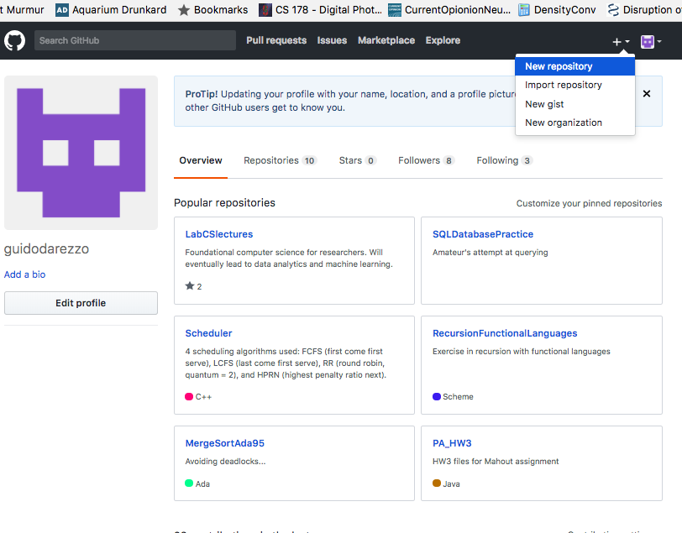
Intro to GitHub
Create a new repository
Multiple files and programmers work under one repository--so it’s a basically an organizational schema for code.
Repositories can be public or private, if you want to restrict access.

Slide 53
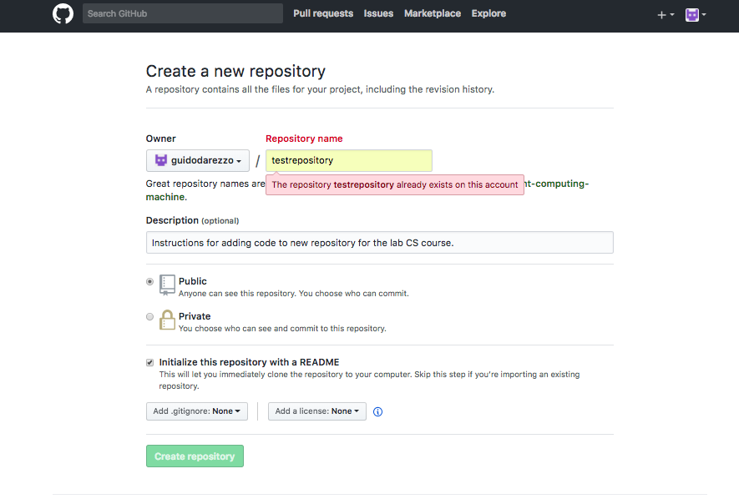
Intro to GitHub
Give your repository a descriptive, succinct name.
Make sure you initialize your repository with a README file.
README files provide information about the project such as how to run it, common bugs, user options, and so forth.

Slide 54
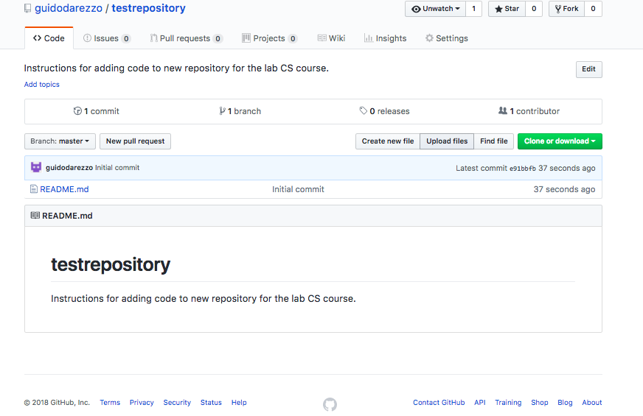
Intro to GitHub
Upload your files by clicking “Upload files.”

Slide 55
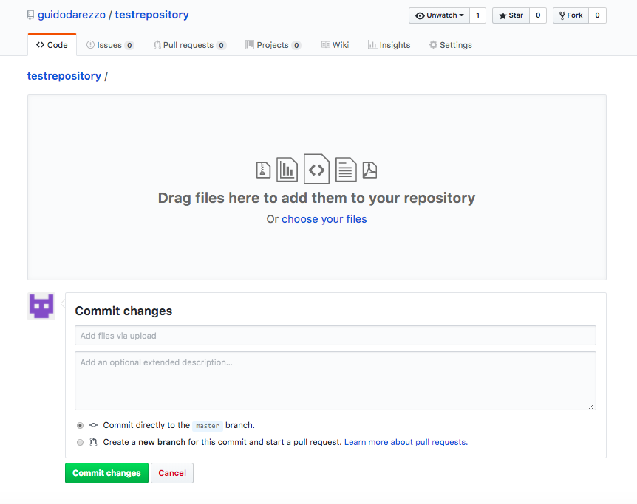
Intro to GitHub
Drag and drop files.
Write a short description of your commit.
A commit is an event that occurs when one or more programmer wants to publish changes to the repository.
Example: added updated slide deck and Week 3 code

Slide 56
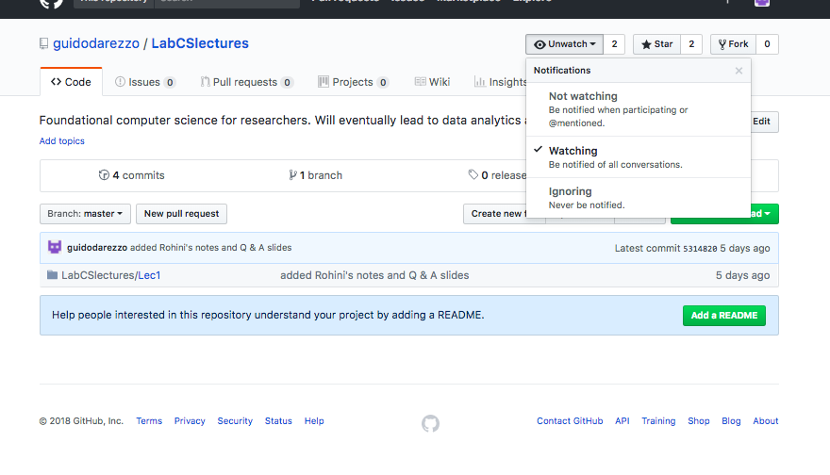
Intro to GitHub
Receive notifications when a repository is updated by watching it.

Slide 57
Boolean data types
Boolean expressions yield boolean data, meaning true or false values
5 + 3 > 2 → True
5 + 3 < 2 → False
Use comparison operators in Boolean expressions

Slide 58
Comparison operators
==
Equality
x == y
Are the values of x and y equal to one another?
!=
Inequality
x != y
This expression is true if x is not equal to y

Slide 59
Comparison operators
>
Greater than
x > y
True if x is greater than y
>=
Greater than OR equal to
x >= y
This expression is true if x is greater than OR equal to y

Slide 60
Comparison operators
<
Less than
x < y
True if x is less than y
<=
Greater than OR equal to
x <= y
This expression is true if x is less than OR equal to y

Slide 61
Comparison operators
= and == ARE NOT interchangeable.
Why?
= assigns values from the right-hand side to the variable on the left hand side.
== will yield ONLY Boolean values.
Inequality does not always require LHS and RHS expressions.
Let us assume there exists some integer x, where x > 5.
!x will yield true for any integer less than or equal to 5.

Slide 62
Logic operators
Why are they different from comparison operators?
They allow for multiple Boolean expressions in one statement.
Let’s suppose there are two expressions we want to evaluate: x <= 7; x > 3
In other words, we want to know if x is in range, (3, 7]
Use logic operator, and to evaluate both expressions at once.
x <= 7 and x > 3

Slide 63
Logic operators
AND operator
In Python, we write it as and.
x = 5
x > 3 and x <= 7 yields True
In other languages, and is represented as & or &&

Slide 64
Logic operators
OR operator
In Python, we write it as or.
x = 5
x > 3 or x <= 7 yields True
Other languages differentiate between the exclusive and inclusive or
Exclusive or, ^ or ^^, yields True IFF (if and only if) one of the statements is true, but not both.
Inclusive or, | or ||, yields True when one or more statements are true.
PYTHON USES INCLUSIVE OR

Slide 65
Conditional statements
Statements that guide the behavior of a program based on one or more Boolean statements.
Programs can make their own decisions while it is running.
Dynamic updates of values.
In Python, the syntax is as follows:
if [Boolean expression]:
[block of code to be executed when if statement is true]
One-way, two-way, multi-way, and nested if statements are possible

Slide 66
One-way if statements
Means we have only one if statement to evaluate.
Example:
x = 5
if x > 10:
print “x is greater than 10!”
## Should evaluate to False, thus printing nothing

Slide 67
Two-way if statements
Directs the behavior of the program when the if block is not executed.
If, else used in conjunction
Example:
x = 5
if x > 10:
print “x is greater than 10!”
else:
print “x is less than or equal to 10!”

Slide 68
Two-way if statements practice
Write a two-way if statement which prints “Fizz” for even numbers and “Buzz” for odd.

Slide 69
Take home messages
Use int(), float(), str() to type cast.
Boolean expressions are constructed with comparison operators (==, !=, >, >=, <, <=). Multiple expressions are interconnected using logic operators (and, or, not).
Use one-way, two-way, multi-way, and nested-if statements to guide behavior of your program.

Slide 70
Foundations of Computer Science for Researchers
Week 5

Slide 71
Goals for this lesson
Finish up conditional statements
Multi-way and nested if statements
Library imports
Practice problems
Lesson5.py homework problems
Homework:
OR choose a self-report questionnaire and turn it into a series of if statements.
OR turn TAB or ART screening into if statements.

Slide 72
Multi-way if statements
If, elif, else used in conjunction
Example:
x = 5 if x > 10: print “x is greater than 10!” elif x == 10: print “x is equal to 10!” else: print “x is less than 10!”

Slide 73
Multi-way if statement practice
Write a multi-way if statement which prints “x is positive” for positive numbers, “x is negative” for negative numbers, and “x is 0” otherwise.

Slide 74
Nested if statements
Can further distinguish between categories.
Kind of like asking follow-up questions...

Slide 75
Nested if statements
if x > 0: if x % 2 == 0: print “positive even number” else: print “positive odd number”
elif x == 0: print “x is 0” else: if x % 2 == 0: print “negative even number” else: print “negative odd number”

Slide 76
Nested if statements practice
Write a series of nested if statements for student grades. You want to print either pass/fail and followed by the student’s letter grade. Please account for -/+ letter grades.

Slide 77
Library imports
Libraries are toolkits for programmer.
Each language has its own libraries.
Libraries are enriched with specialized functions such as cosine, sine, tangent, rounding up and down.
In Python, import statements are declared at the beginning of a module.
Common Python libraries are Math and Random.
Math toolkit gives you rounding functions (ceil, floor), trig functions, factorial, etc.
Random generates random numbers for you.
Documentation

Slide 78
Library imports
import math, random
print(math.ceil(7.8))
## change the integers in the parentheses if you want to adjust the range print(random.randint(1,3))
**additional examples in code
Try it yourself!
Look at the documentation, see what you can do.

Slide 79
Foundations of Computer Science for Researchers
Week 6

Slide 80
Goals for this lesson
Shortcut operators
Begin learning about repetition/iteration structures.
While loops (primary focus of this lesson)
For loops
Nested loops

Slide 81
Shortcut operators
Let’s start with x = 10
+=
Add value from RHS to value on the LHS.
x += 1, we will get 11, 12, 13, 14, and so on…
Equivalent to x = x + 1
-=
Subtract values from LHS by value on RHS.
x -= 1, we will get 9, 8, 7, 6, and so on…
Equivalent to x = x - 1
*=
Multiply values on LHS by value on RHS
x *= 2, we will get 20, 40, 80, 160, and so on...
Equivalent to x = x * 2

Slide 82
Shortcut operators
Let’s start with x = 40
/=
Add divide value on LHS by value on RHS.
x /= 2, we will get 20, 10, 5, and so on…
Equivalent to x = x / 2
%=
Get modulus of value on LHS by the value on RHS.
x %= 3 we will get 1, 1, 1, and so on…
Equivalent to x = x % 3

Slide 83
Iteration structures
Used to repetitively perform some action until termination condition is satisfied.
Components are initialization, termination condition, and update.

Slide 84
While loops
## initialize some variable. This should keep track of the iterations of your loop. counter = 0
## write the termination condition of your while loop while counter < 5: print “counter =”, counter ## now update the value of counter counter += 1
How many times will this loop print counter? Try it out...
Notes:
******WRITE THIS OUT ON IDE******

Slide 85
While loops
The loop will terminate when the termination condition is satisfied.
What happens when we do not update?
Loop will go on infinitely…
Updating ensures that we will satisfy the termination condition at some preset event.
What if we never initialize?
We will never start the loop.
Or, dependent upon the program structure, the loop will execute infinitely.

Slide 86
While loop practice problem
Ask your user for a positive integer. Build a loop that prints out every number from 1 to that integer (inclusive). If the user inputs 5, your program should print 1, 2, 3, 4, 5.

Slide 87
While loop practice problem
num = int(raw_input("Please enter a positive integer: "))
counter = 1
while counter <= num:
print counter
counter += 1

Slide 88
While loop practice problem
Write a program where you print the counter value 5 times. If the counter is even, print “Fizz!” If the counter is odd, print “Buzz!”
Incorporate your understanding of conditional statements into your loop.

Slide 89
While loop practice problem
## initialize! counter = 0
## termination condition!! while counter < 5: print counter if (counter % 2) == 0: print “Fizz!” else: print “Buzz!”
## update!!! counter += 1

Slide 90
While loop practice problem
Let us transform a problem from earlier, which queried the user for monthly transportation expenditure and outputted the monthly average.
Ask the user how much he/she/they spent in a month. Do this three times. Calculate the average and print it out to the console.

Slide 91
While loop practice problem
total = 0
## initialize!
counter = 0
## termination condition!!
while counter < 3:
print "Month", counter + 1
total += float(raw_input("How much on transportation this month? "))
## update!!!
counter += 1
print "In the last three months, you spent an average of", total / 3, "per month"

Slide 92
While loops practice problem
Write a program to calculate 5 factorial.
Notes:
### Give them 7 - 10 minutes to solve this. See code for this answer ###

Slide 93
While loops practice problem
fac = 5 ## Initialize! counter = 4 ## termination condition! while counter > 0: fac *= counter print fac ## update! counter -= 1
Notes:
### Give them 7 - 10 minutes to solve this. See code for this answer ###

Slide 94
While loops practice problem
Write a program where you calculate exponentials for the user. Ask the user for the base number and its exponent. Calculate the answer using a loop, and print the result of each iteration.
Notes:
### Give them 7 - 10 minutes to solve this. See code for this answer ###

Slide 95
While loops
base = int(raw_input(“Enter the base: “)) exp = int(raw_intput(“Enter the exponent: “)) ## Initialize counter = 0 result = 1 ## termination condition while counter < exp: result = result * base print results ## update! counter += 1

Slide 96
Take home messages
Initialize, set the termination condition, UPDATE
Think about why, why, why we need these steps…
Use loops for repetitive actions
Asking for user input
Performing calculations
What else?

Slide 97
Foundations of Computer Science for Researchers
Week 7

Slide 98
Goals for this lesson
Introduction to for loops
Understand differences between for and while loops

Slide 99
Basic structure of for loop in Python
for <some variable> in <iterable set of items>: <body of loop>
for i in [1, 2, 3, 4, 5]: print i
for fruit in [“apples”, “oranges”, “kumquats”, “mangosteens”]: print fruit

Slide 100
for loops practice problem
Write a for loop that prints out the names of your family members.
Notes:
### Give them 7 - 10 minutes to solve this. See code for this answer ###

Slide 101
for loops practice problem
for name in [“Shannon”, “Laura”, “Sonia”]: print name
Notes:
### Give them 7 - 10 minutes to solve this. See code for this answer ###

Slide 102
range() function
range(<end_value>)
Will iterate from 0 to end_value - 1.
range(<start_value>, <end_value>)
Will iterate from start_value to end_value - 1.
range(<start_value>, <end_value>, <step_size>)
Will iterate from start_value to end_value - 1 by the step_size.

Slide 103
for loops practice problem
Write a for loop that prints every number from 5 to 10.
Notes:
### Give them 7 - 10 minutes to solve this. See code for this answer ###

Slide 104
for loops practice problem
for i in range(5, 11): print i
Notes:
### Give them 7 - 10 minutes to solve this. See code for this answer ###

Slide 105
for loops practice problem
Write a for loop that prints every even number from 2 to 10.
Notes:
### Give them 7 - 10 minutes to solve this. See code for this answer ###

Slide 106
for loops practice problem
for i in range(2, 11, 2): print i
Notes:
### Give them 7 - 10 minutes to solve this. See code for this answer ###

Slide 107
Differences between while and for loops
Where do you initialize, write a termination condition, and update in a for loop?
Initialization: usually done inside of the for statement.
Termination condition: also done inside of the for statement.
Update: either in the for statement or in the body of the loop.
Same logic, different structure.
Both while loops and for loops will produce the same result.
Calculating sums, products.
Controlling for even/odd integers.
Sometimes, structural differences make logic easier to understand...

Slide 108
While loop use case
Best when you don’t need a counter.
Or when you don’t know how many times you need to loop...
Instances when you want to keep looping until you get the correct response from the user.
my_name = “Caroline” your_name = “”
while my_name != your_name: your_name = raw_input(“What is your name? “)

Slide 109
For loop use case
Best for iterating through lists.
When you know the number of iterations.
result = 0
for i in range (2, 11, 2): result += i

Slide 110
Transform this while loop to a for loop
## initialize! counter = 0
## termination condition!! while counter < 5: print counter if (counter % 2) == 0: print “Fizz!” else: print “Buzz!”
## update!!! counter += 1

Slide 111
Transform this while loop to a for loop
for counter in range (0, 5): print counter if (counter % 2) == 0: print “Fizz!” else: print “Buzz!”

Slide 112
Transform this while loop
base = int(raw_input(“Enter the base: “)) exp = int(raw_intput(“Enter the exponent: “)) ## Initialize counter = 0 result = 1 ## termination condition while counter < exp: result *= base print result ## update! counter += 1

Slide 113
Transform this while loop
base = int(raw_input(“Enter the base: “)) exp = int(raw_intput(“Enter the exponent: “)) result = 1
for counter in range (0, exp): result *= base print result

